Slide 1
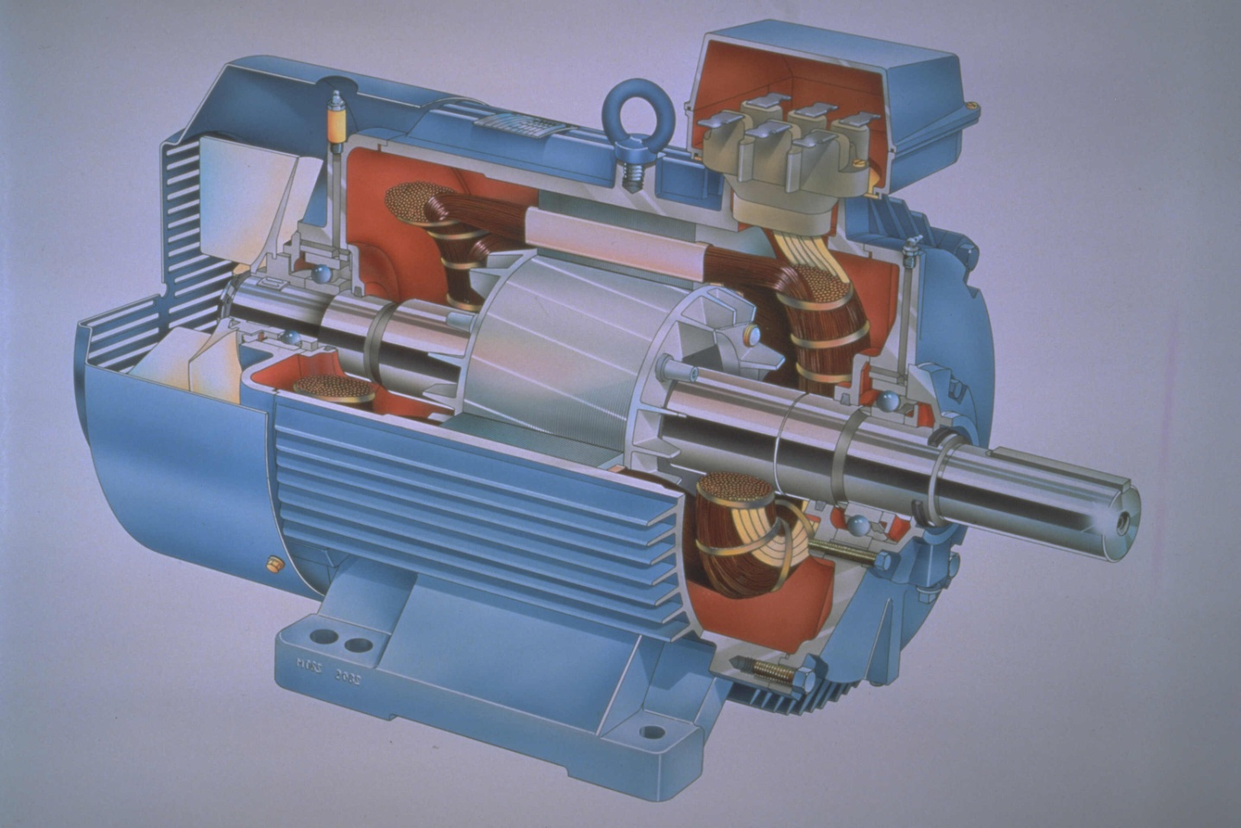
Induction Motors

Slide 2
Introduction
Three-phase induction motors are the most common and frequently encountered machines in industry
  simple design, rugged, low-price, easy maintenance
  wide range of power ratings: fractional horsepower to 10 MW
  run essentially as constant speed from zero to full load
  speed is power source frequency dependent
    not easy to have variable speed control
    requires a variable-frequency power-electronic drive for optimal speed control

Slide 3
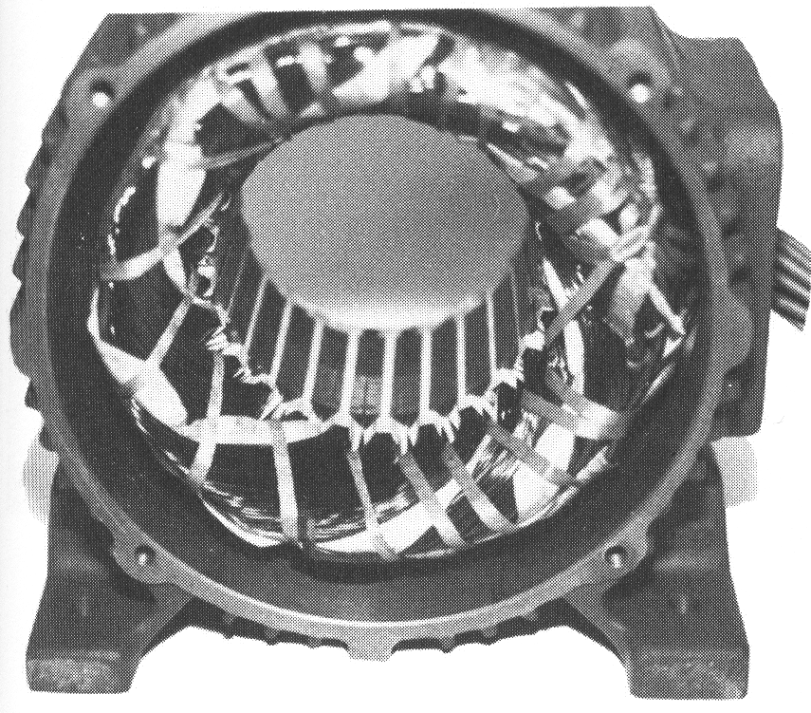
Construction
An induction motor has two main parts
  a stationary stator
    consisting of a steel frame that supports a hollow, cylindrical core
    core, constructed from stacked laminations (why?), having a number of evenly spaced slots, providing the space for the stator winding
Stator of IM

Slide 4
Construction
  a revolving rotor
    composed of punched laminations, stacked to create a series of rotor slots, providing space for the rotor winding
    one of two types of rotor windings
    conventional 3-phase windings made of insulated wire (wound-rotor) » similar to the winding on the stator
    aluminum bus bars shorted together at the ends by two aluminum rings, forming a squirrel-cage shaped circuit (squirrel-cage)
Two basic design types depending on the rotor design
  squirrel-cage
  wound-rotor

Slide 5
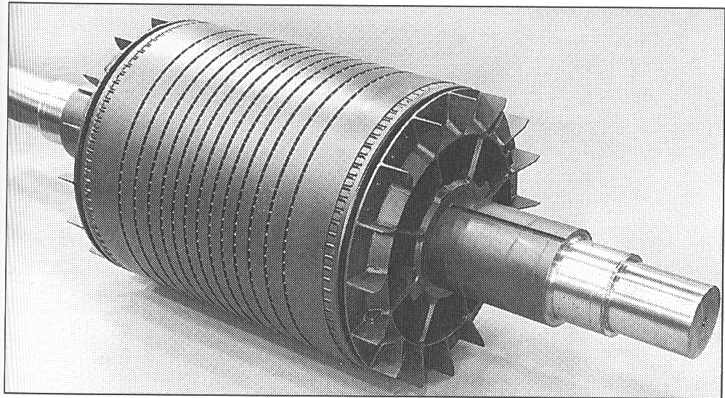
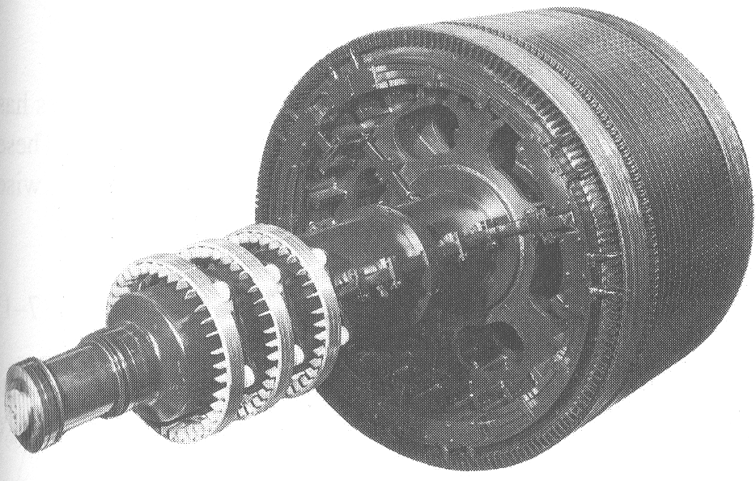
Construction
Squirrel cage rotor
Wound rotor
Notice the slip rings

Slide 6
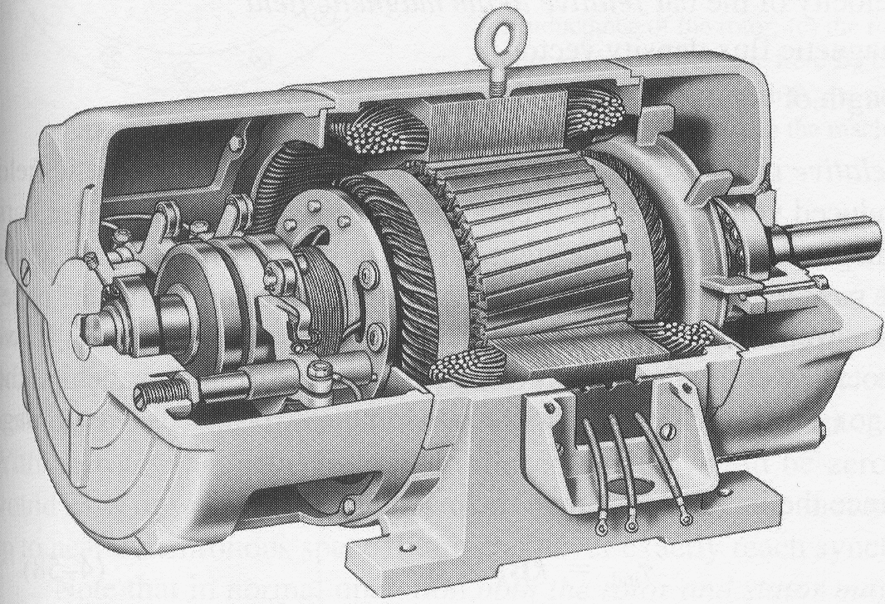
Construction
Slip rings
Cutaway in a typical wound-rotor IM. Notice the brushes and the slip rings
Brushes

Slide 7
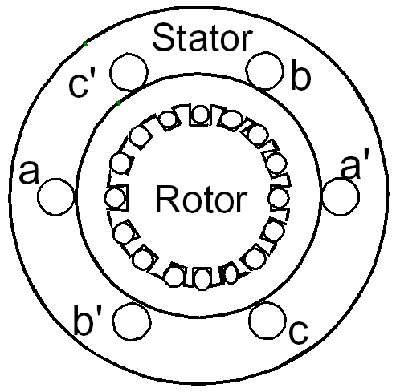
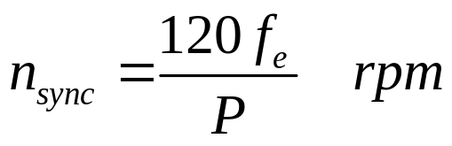
Rotating Magnetic Field
Balanced three phase windings, i.e. mechanically displaced 120 degrees form each other, fed by balanced three phase source
A rotating magnetic field with constant magnitude is produced, rotating with a speed
Where f_{e} is the supply frequency and P is the no. of poles and n_{sync} is called the synchronous speed in rpm (revolutions per minute)

Slide 8
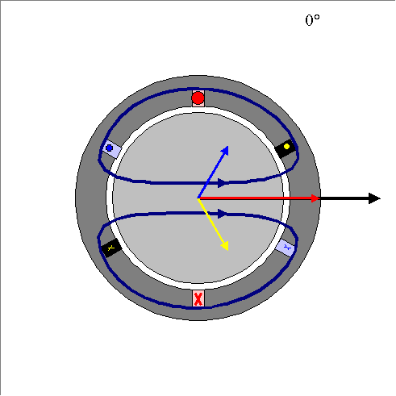
Rotating Magnetic Field

Slide 9
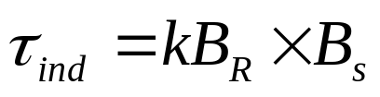
Principle of operation
This rotating magnetic field cuts the rotor windings and produces an induced voltage in the rotor windings
Due to the fact that the rotor windings are short circuited, for both squirrel cage and wound-rotor, and induced current flows in the rotor windings
The rotor current produces another magnetic field
A torque is produced as a result of the interaction of those two magnetic fields
Where τ_{ind} is the induced torque and B_{R} and B_{S} are the magnetic flux densities of the rotor and the stator respectively

Slide 10
Induction motor speed
At what speed will the IM run?
  Can the IM run at the synchronous speed, why?
  If rotor runs at the synchronous speed, which is the same speed of the rotating magnetic field, then the rotor will appear stationary to the rotating magnetic field and the rotating magnetic field will not cut the rotor. So, no induced current will flow in the rotor and no rotor magnetic flux will be produced so no torque is generated and the rotor speed will fall below the synchronous speed
  When the speed falls, the rotating magnetic field will cut the rotor windings and a torque is produced

Slide 11
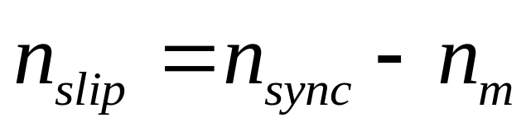
Induction motor speed
So, the IM will always run at a speed lower than the synchronous speed
The difference between the motor speed and the synchronous speed is called the Slip
  Where n_{slip}= slip speed
  n_{sync}= speed of the magnetic field
  n_{m} = mechanical shaft speed of the motor

Slide 12
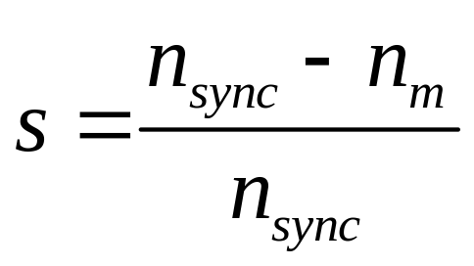
The Slip
Where s is the slip
Notice that : if the rotor runs at synchronous speed
s = 0
if the rotor is stationary
s = 1
Slip may be expressed as a percentage by multiplying the above eq. by 100, notice that the slip is a ratio and doesn’t have units

Slide 13
Example 7-1 (pp.387-388)
A 208-V, 10hp, four pole, 60 Hz, Y-connected induction motor has a full-load slip of 5 percent
  What is the synchronous speed of this motor?
  What is the rotor speed of this motor at rated load?
  What is the rotor frequency of this motor at rated load?
  What is the shaft torque of this motor at rated load?

Slide 14
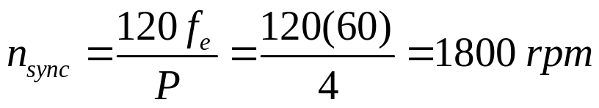
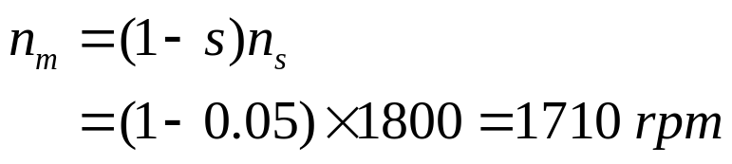
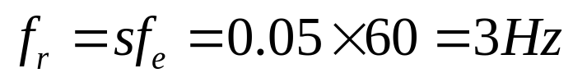
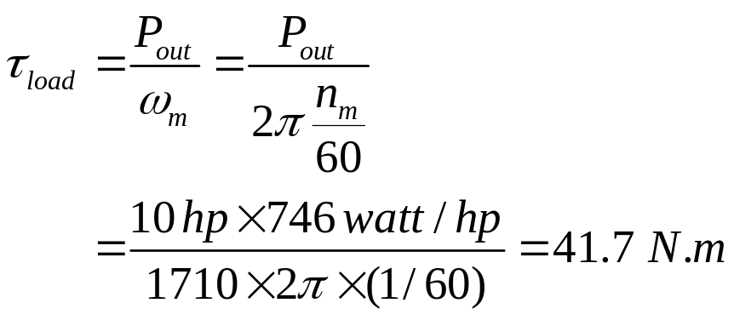
Solution

Slide 15
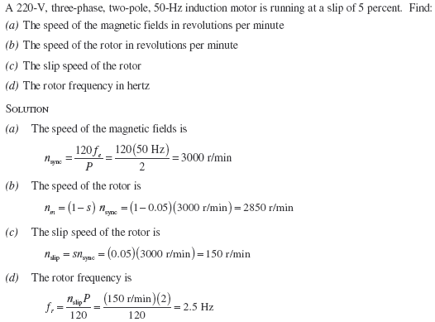
Problem 7-2 (p.468)

Slide 16
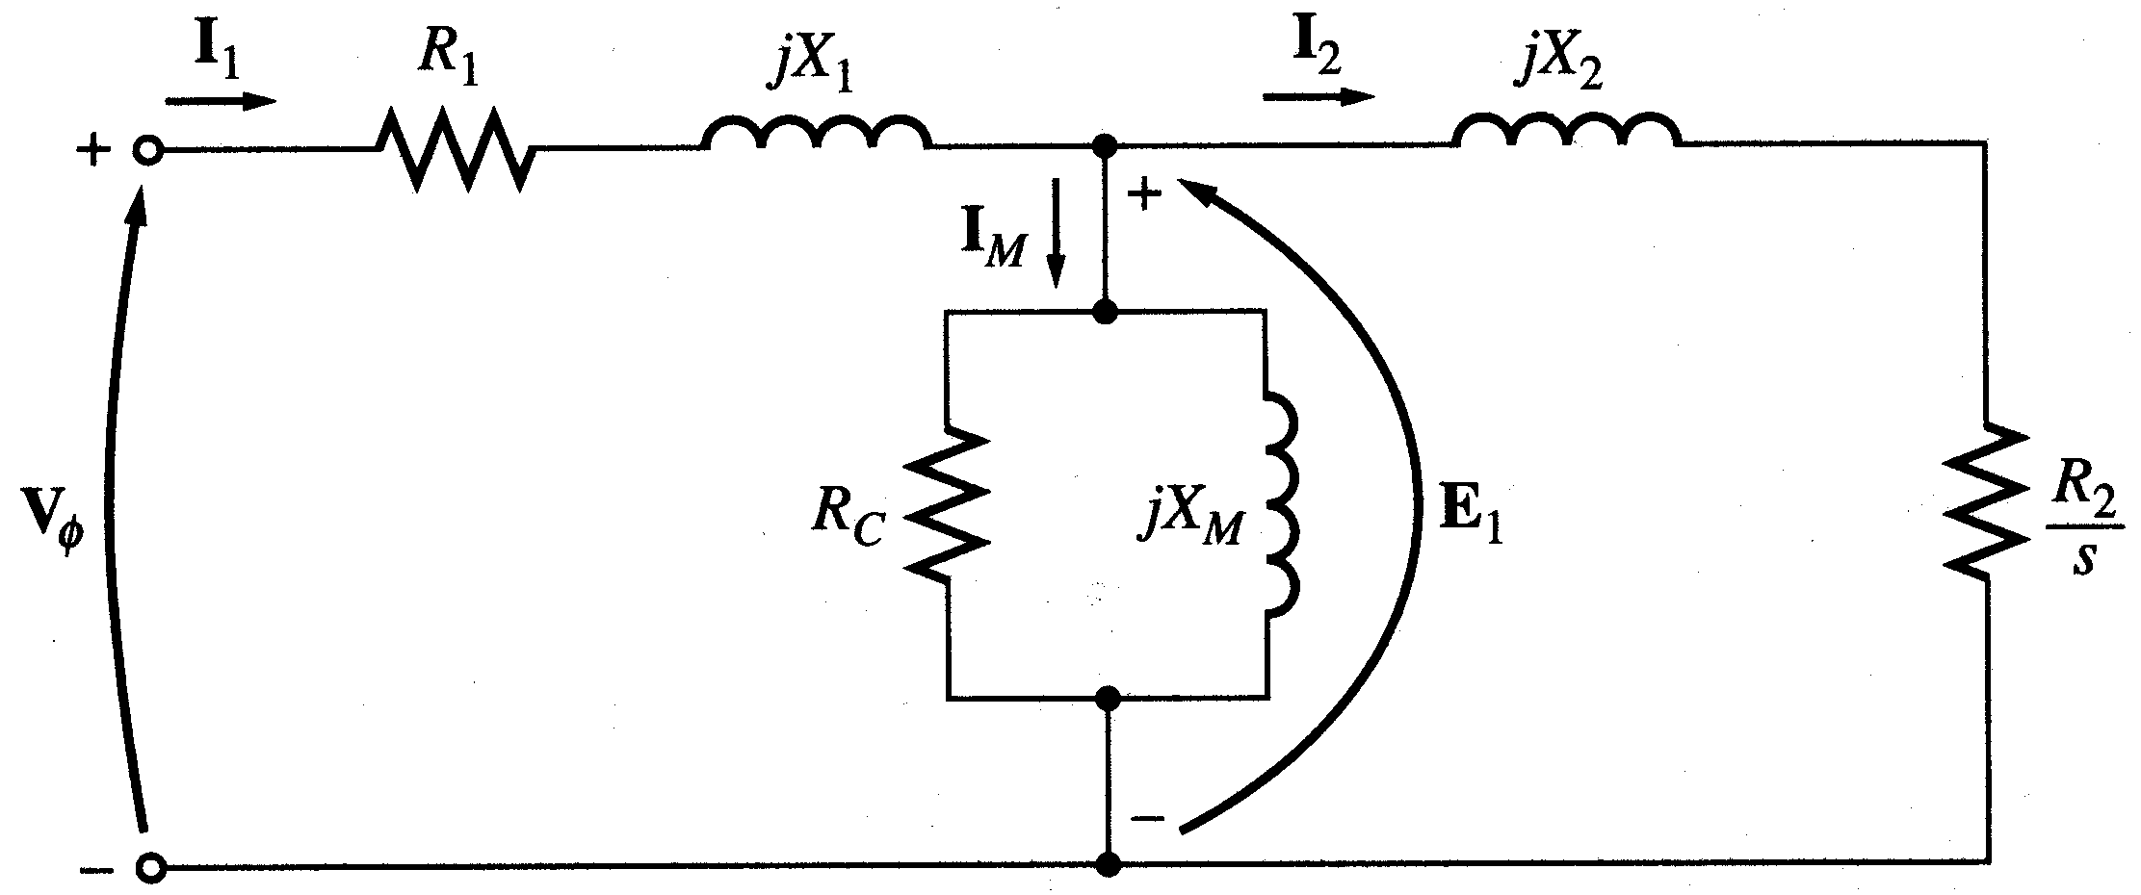
Equivalent Circuit

Slide 17
Power losses in Induction machines
Copper losses
  Copper loss in the stator (P_{SCL}) = I₁²R₁
  Copper loss in the rotor (P_{RCL}) = I₂²R₂
Core loss (P_{core})
Mechanical power loss due to friction and windage
How this power flow in the motor?

Slide 18
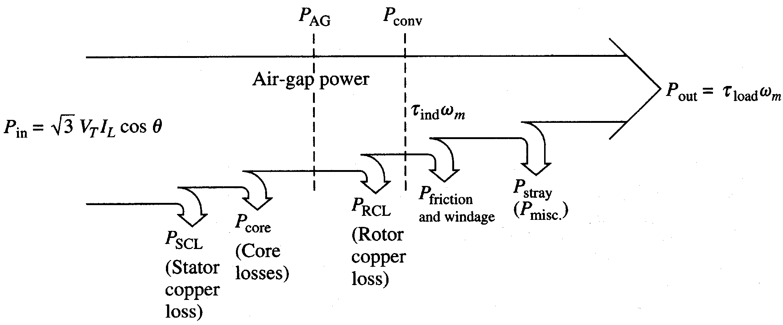
Power flow in induction motor

Slide 19
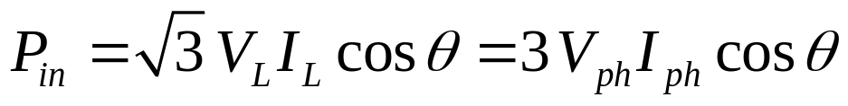
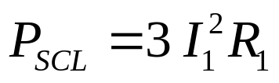
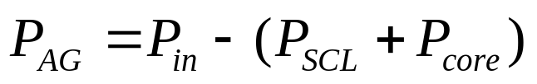
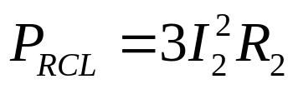
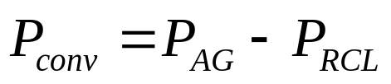
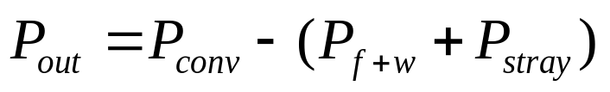
Power relations

Slide 20
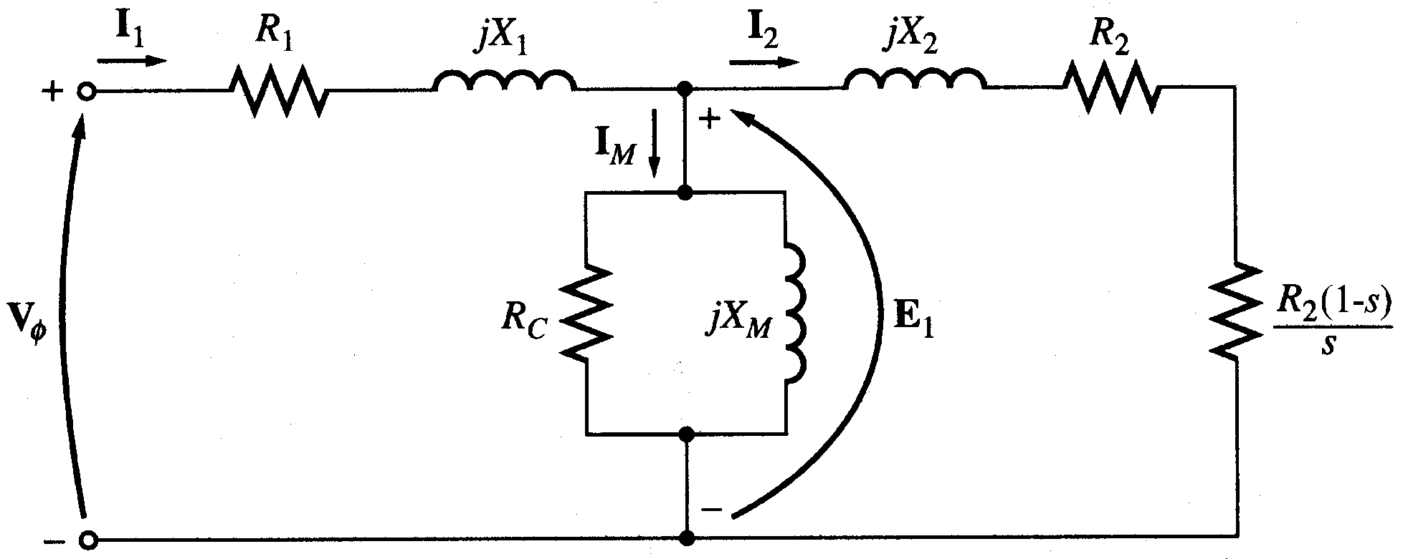
Equivalent Circuit
We can rearrange the equivalent circuit as follows
Resistance equivalent to mechanical load
Actual rotor resistance

Slide 21
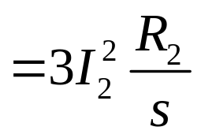
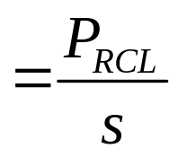
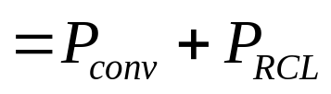
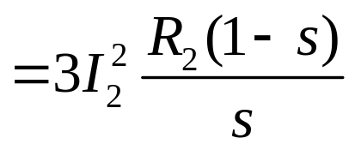
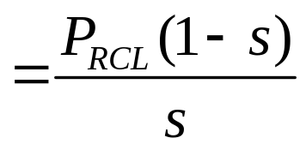
Power relations

Slide 22
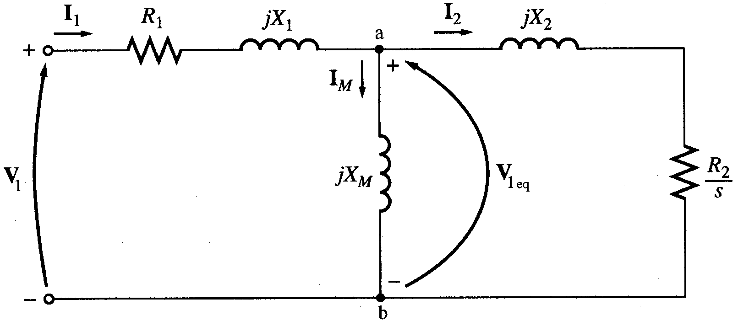
Torque, power and Thevenin’s Theorem
Thevenin’s theorem can be used to transform the network to the left of points ‘a’ and ‘b’ into an equivalent voltage source V_{1eq} in series with equivalent impedance R_{eq}+jX_{eq}

Slide 23
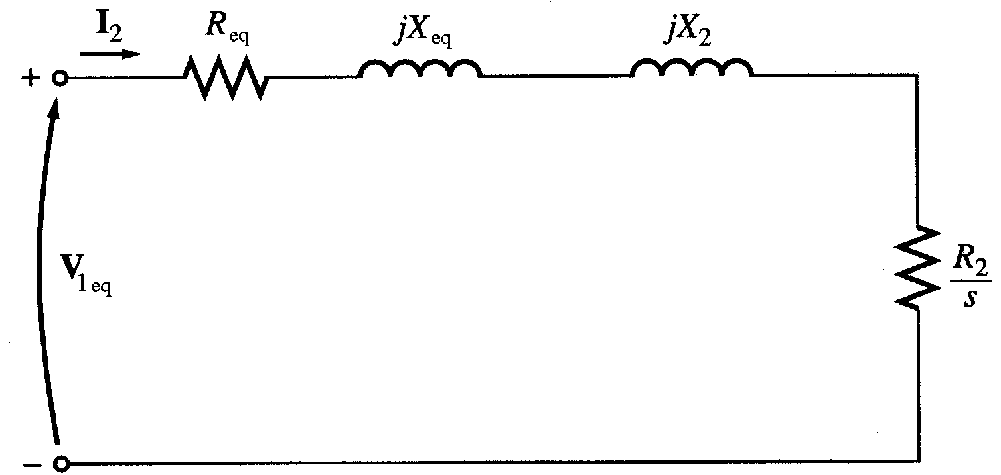
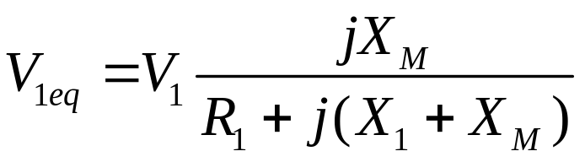
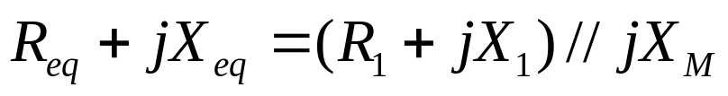
Torque, power and Thevenin’s Theorem

Slide 24
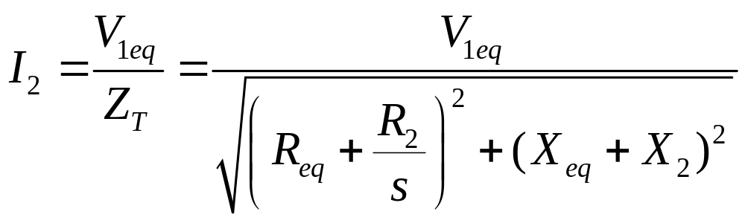
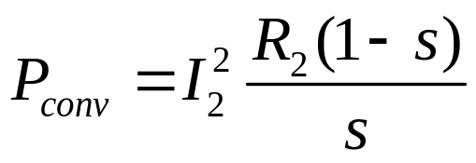
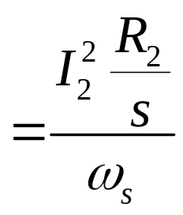
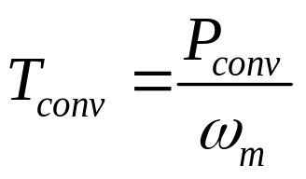
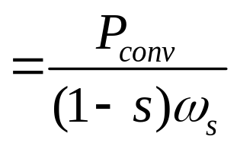
Torque, power and Thevenin’s Theorem
Then the power converted to mechanical (P_{conv})
And the internal mechanical torque (T_{conv})

Slide 25
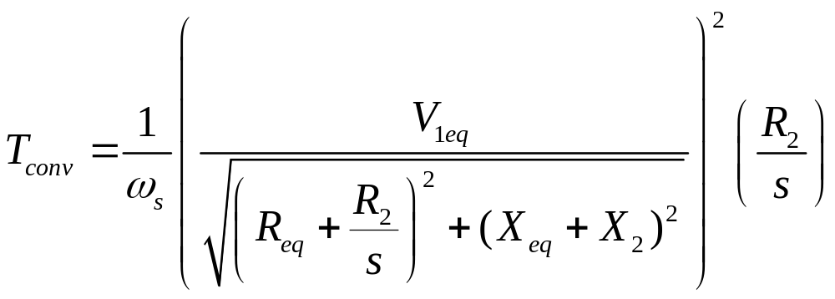
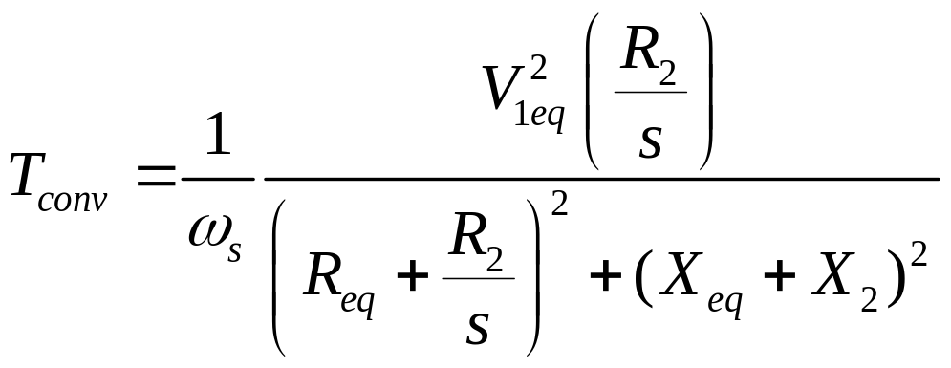
Torque, power and Thevenin’s Theorem

Slide 26
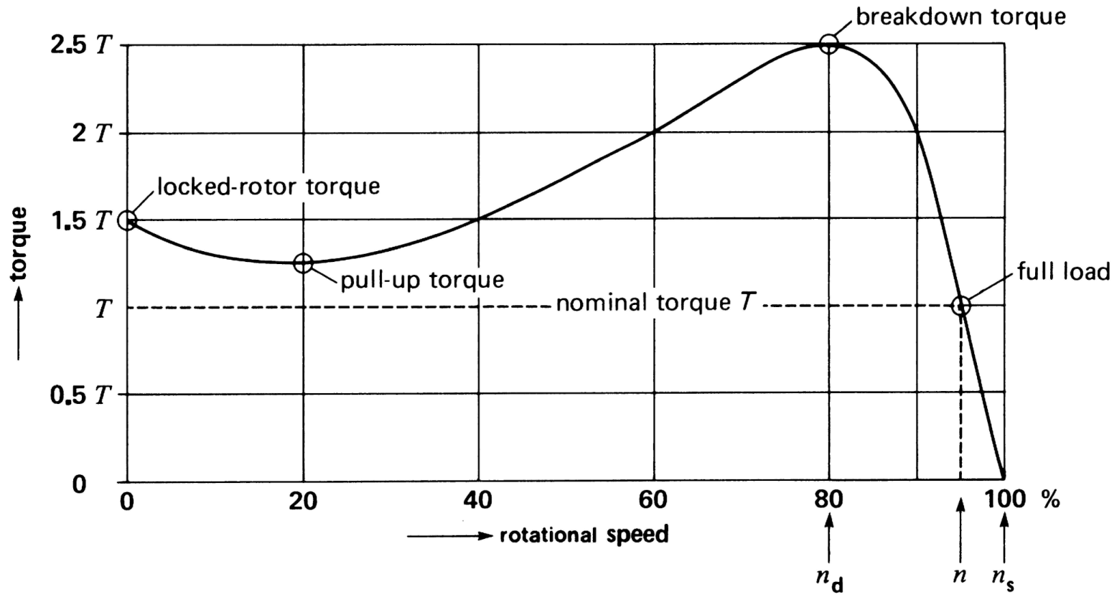
Torque-speed characteristics
Typical torque-speed characteristics of induction motor

Slide 27
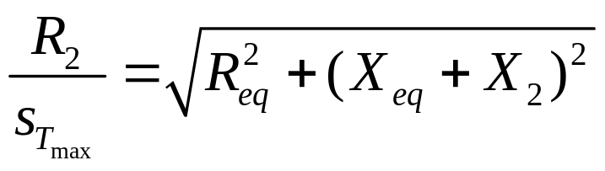
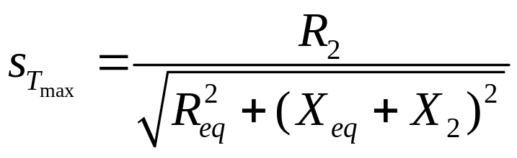
Maximum torque
Maximum torque occurs when the power transferred to R₂/s is maximum.
This condition occurs when R₂/s equals the magnitude of the impedance R_{eq} + j (X_{eq} + X₂)

Slide 28
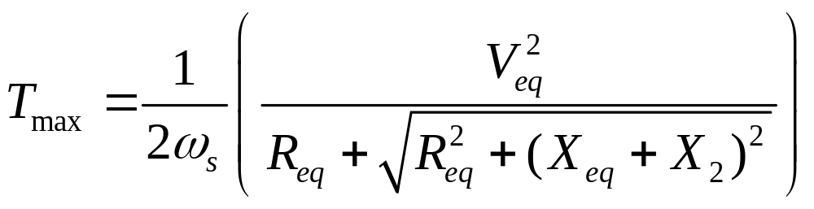
Maximum torque
The corresponding maximum torque of an induction motor equals
The slip at maximum torque is directly proportional to the rotor resistance R₂
The maximum torque is independent of R₂

Slide 29
Maximum torque
Rotor resistance can be increased by inserting external resistance in the rotor of a wound-rotor induction motor.
The value of the maximum torque remains unaffected but the speed at which it occurs can be controlled.

Slide 30
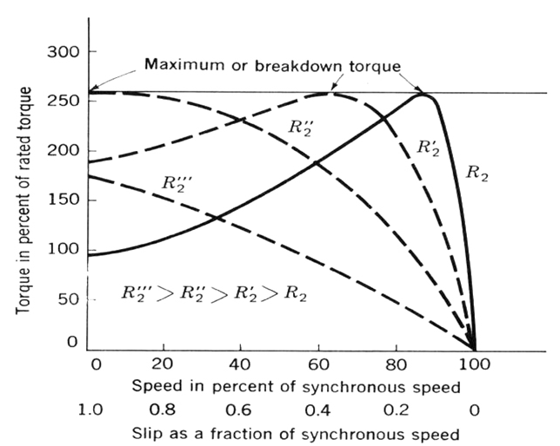
Maximum torque
Effect of rotor resistance on torque-speed characteristic

Slide 31
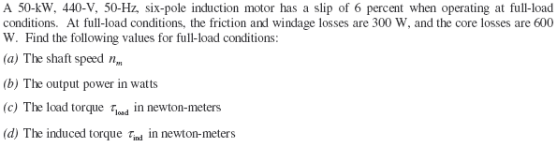
Problem 7-5 (p.468)

Slide 32
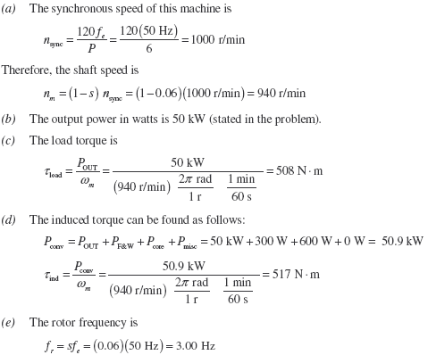
Solution to Problem 7-5 (p.468)

Slide 33
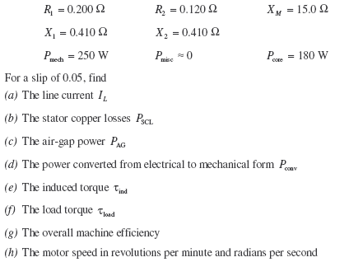
Problem 7-7 (pp.468-469)

Slide 34
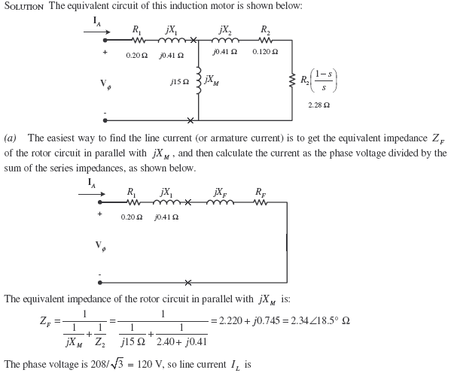
Solution to Problem 7-7 (pp.468-469)

Slide 35

Solution to Problem 7-7 (pp.468-469) – Cont’d

Slide 36

Solution to Problem 7-7 (pp.468-469) – Cont’d

Slide 37

Problem 7-19 (p.470)

Slide 38

Solution to Problem 7-19 (pp.470)

Slide 39

Solution to Problem 7-19 (pp.470) – Cont’d

Slide 40


Solution to Problem 7-19 (pp.470) – Cont’d

Slide 41

Solution to Problem 7-19 (pp.470) – Cont’d

